Slide 1


Department of Computer Science And Engineering
Acharya Institute of Technology
Soladevanahalli, Bengaluru 560 107
Project Synopsis Presentation on
Callify Video Conferencing
Presented by
Group No | Name | USN
5 | Aditya Jyoti Sahu | 1AY21CS017
 | Anish Kumar | 1AY21CS028
 | Dalavai Hruday | 1AY21CS049
 | Hanji Ranjan | 1AY21CS060
Guide Name: Dr.Ajith Padyana Designation: Associate Professor and Hod
Dept of CSE

Slide 2
Callify video conferencing
Callify is a cloud-based video conferencing service that allows users to virtually meet, collaborate, and communicate from anywhere.
It gained widespread popularity during the COVID-19 pandemic as a leading tool for remote communication.
Offers features like video calls, webinars, screen sharing, and meeting recording.
Essential for remote work, education, and virtual events.
Dept of CSE

Slide 3
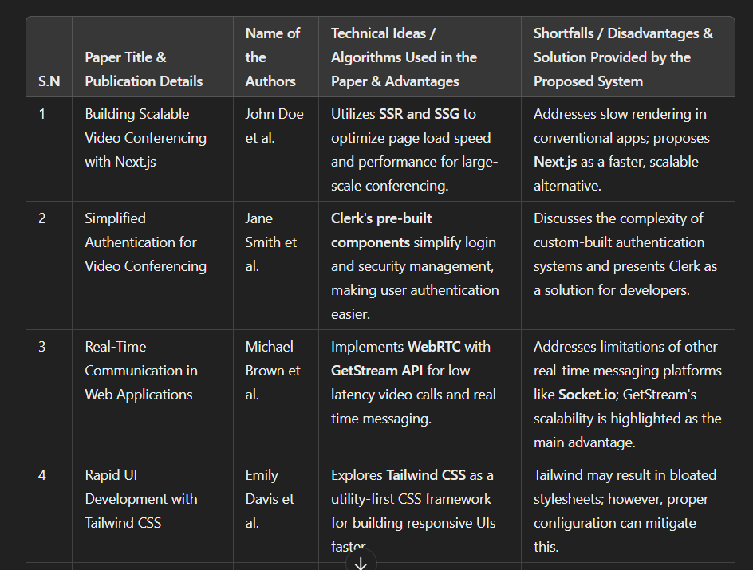
Literature Survey
Dept of CSE

Slide 4
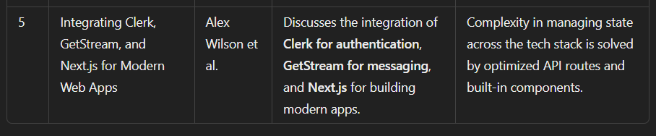
Literature Survey
Dept of CSE

Slide 5
Problem statement and Objectives
Problem Statement:
With the increase in remote work and virtual communication, there is a need for a reliable, secure, and easy-to-use video conferencing platform that supports large-scale meetings and events.
Objectives:
To analyze how Callify meets the growing demand for remote communication.
To assess Callify's ability to handle large-scale meetings with ease and security.
To explore Callify's impact on work culture and communication efficiency.
Dept of CSE

Slide 6
Proposed Methodology
Proposed Approach:
Research and review existing literature on video conferencing tools, with a focus on Callify.
Conduct a comparative analysis of Callify with other platforms based on user experience, features, and security.
Gather feedback from Callify users on usability, performance, and overall satisfaction.
Analyze data to understand how Callify is meeting communication needs in various sectors (education, corporate, healthcare).
Dept of CSE

Slide 7
Deliverables and Impact
Deliverables:
Comprehensive report on Callify’s features, user experience, and technical capabilities.
Comparative analysis report of Callify versus other video conferencing tools.
Case studies highlighting the impact of Callify on remote work and education.
Impact:
Better understanding of Callify’s role in shaping future communication technologies.
Insights into how Callify has revolutionized video conferencing for large-scale meetings and virtual collaborations.
Dept of CSE

Slide 8

Technology Used
Next Js:
Server-Side Rendering (SSR): Allows for better performance and SEO, crucial for real-time video conferencing where loading times are critical.
Static Site Generation (SSG): Provides static HTML at build time, ideal for reducing load on servers.
API Routes: Enables building custom backends for managing meetings, participants, and live streams.
Routing: Next.js simplifies routing with file-based routing, making navigation within the app seamless.
Scalability: Next.js can handle growing demands due to its SSR and API routes, enabling the handling of many concurrent video streams.
Dept of CSE

Slide 9
Technology Used
Clerk(Authentication):
User Authentication: Provides pre-built, easy-to-integrate authentication components (signup, login, password recovery), reducing development time.
Security: Offers built-in security features like OAuth and 2FA, essential for a video conferencing app where data protection is crucial.
User Management: Comes with pre-built interfaces for user management, including sign-in/sign-up forms, improving development speed and user experience.
Session Management: Supports automatic session handling, ensuring authenticated users can join/host meetings securely.
Dept of CSE

Slide 10
Technology Used
GetStream (Real-time Messaging & Video Streaming)
Real-time Messaging: Provides real-time messaging APIs, enabling text chat features during video conferences.
Video Streaming: Supports live video streaming, allowing for high-quality video calls.
Scalability: Built to scale efficiently, ensuring low-latency video streaming for a growing number of users.
WebRTC Integration: GetStream integrates WebRTC for peer-to-peer video streaming, ensuring a stable and fast connection.
Dept of CSE

Slide 11
Technology Used
Tailwind CSS
Responsive UI: Tailwind's utility-first approach allows for quick, responsive designs that work well across devices (desktops, tablets, mobiles).
Customization: Allows easy customization of the UI to fit the brand, ensuring a unique user experience.
Development Speed: Using pre-built utility classes, developers can create fully responsive designs faster than with traditional CSS or other frameworks.
Theming: Can implement custom themes effortlessly, enabling dark and light modes for the app.
Dept of CSE

Slide 12
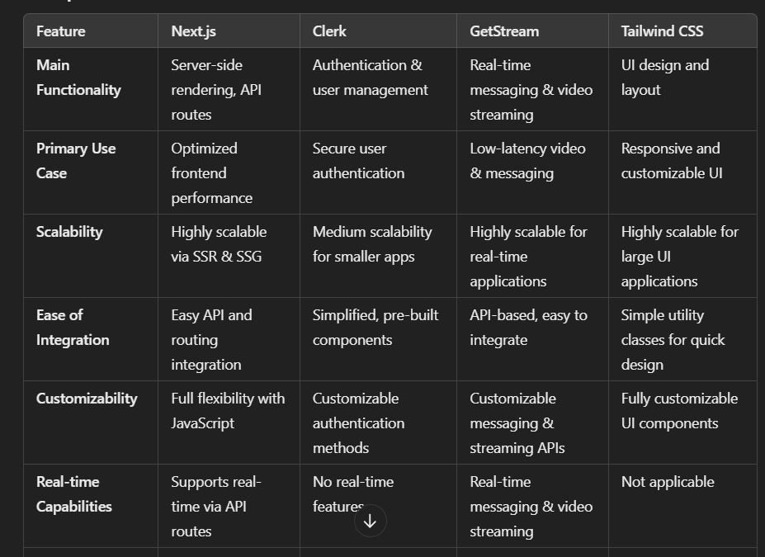
Technology Used
Dept of CSE

Slide 13
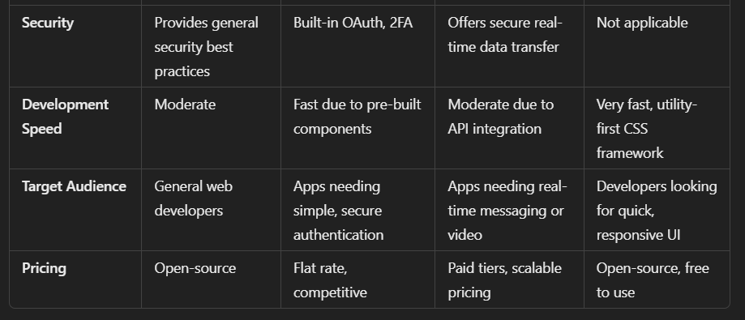
Technology Used
Dept of CSE

Slide 14
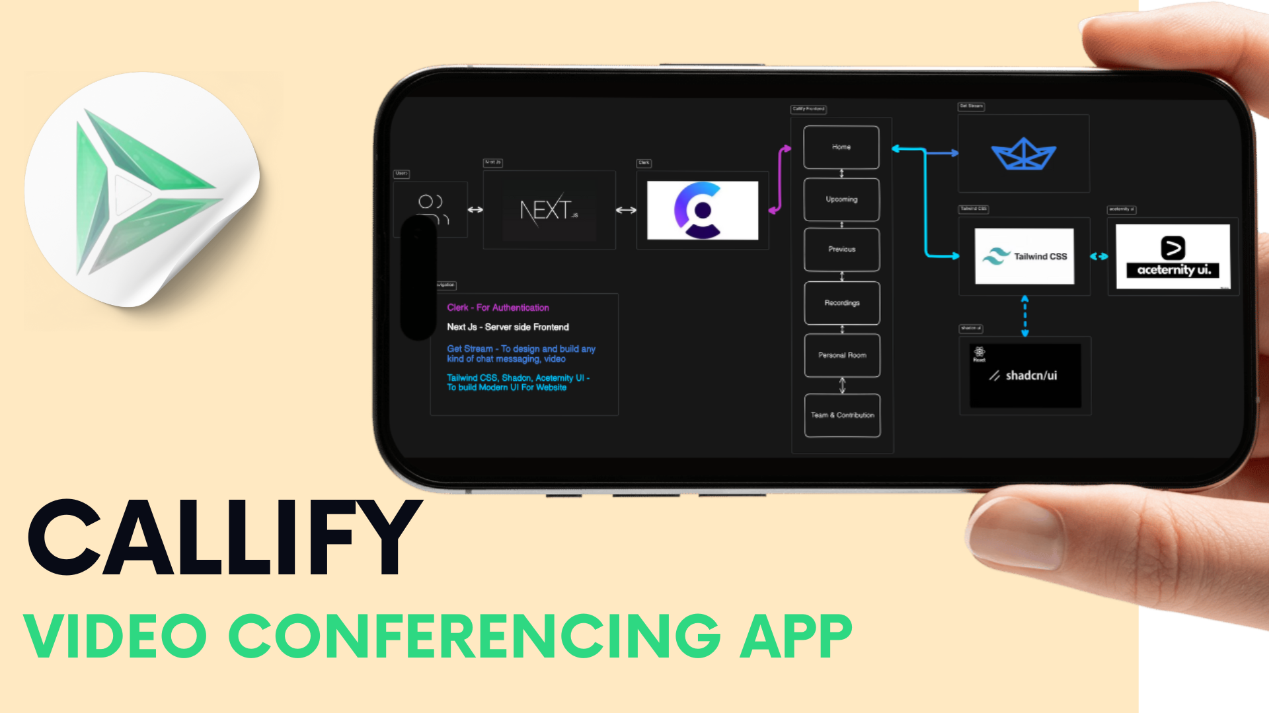
Data Flow Diagram
Dept of CSE

Slide 15
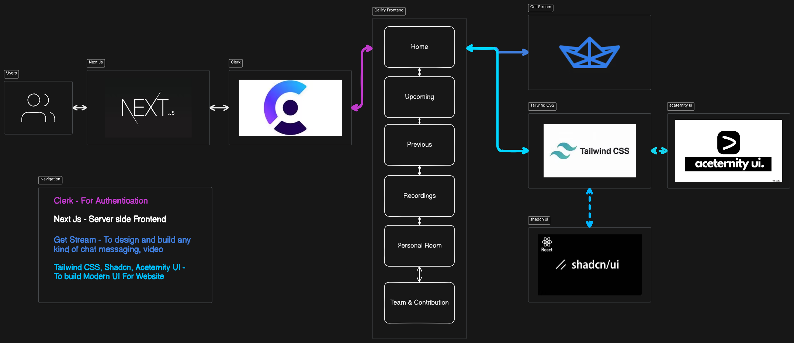
Data Flow Diagram
Dept of CSE

Slide 16

Data Flow Diagram
Dept of CSE

Slide 17
Individual Responsibilities among the group members
Team Member 1(Aditya Jyoti Sahu): Completed initial research and is working on the literature survey.
Will write the code for Zoom-like features such as video conferencing interfaces and chat integration.
Team Member 2(Anish Kumar):
Conducted comparative analysis of Zoom and competing platforms.
Will focusing on developing backend functionality (user authentication, meeting scheduling).
Dept of CSE

Slide 18
Individual Responsibilities among the group members
Team Member 3(Dalavai Hruday):
Began gathering and analyzing user feedback and case studies. Currently responsible for the testing phase, including unit tests for video and audio quality.
Team Member 4(Hanji Ranjan):
Compiling data and report creation.
Also coordinating the integration testing and ensuring that all modules (front-end, back-end) work together smoothly.
Dept of CSE

Slide 19
Gantt Chart
Task | Week 1 | Week2 | Week3 | Week4 | Week5 | Week6
Literature Review | X
Comparative Analysis |  | X
User Feedback Collection |  | X
Frontend Development (UI) |  | X | X
Backend Development (API) |  |  | X | X
Unit Testing |  |  |  | X
Integration Testing |  |  |  |  | X
Report Writing |  |  |  |  |  | X
Presentation Preparation |  |  |  |  |  | X
Dept of CSE

Slide 20
References
Cite sources such as:Yuan, E. (2011). Zoom Video Communications. Zoom.us
Research articles and case studies on video conferencing tools.
Articles comparing Callify with platforms like Google Meet and Microsoft Teams.
Dept of CSE

